Slide 1
WRAP Regional Technical Operations Work Group (RTOWG) and Regional Haze Control Measures Subcommittee (CMS)
Options for Single-Source Visibility Ranking/Evaluation with Modeling Tools
Ralph Morris
Ramboll
Webinar to support development of recommendations for Regional Haze planning analyses
December 12, 2018

Slide 2
Background
States need to identify anthropogenic emission sources that most likely contribute to visibility impairment on the Most Impaired Days (MID) at a Class I Area (CIA)
Such sources are subjected to a Four-Factor Analysis to determine whether reasonable controls should be implemented as part of Reasonable Progress for the 2nd Round of Regional Haze SIPs due in 2021
  Costs of compliance
  Time necessary for compliance
  Energy and non-air quality environmental impacts of compliance
  Remaining useful life

Slide 3
Background – Control Measures Subcommittee (CMS)
Control Measures Subcommittee (CMS) of the WRAP Regional Haze Planning Work Group has prepared a draft “Reasonable Progress Source Identification and Analysis Protocol” to promote consistency among WRAP states in identifying sources subject to the Four-Factor Analysis
  The number sources and level of emissions assessed by each state will vary, but a “reasonably large fraction” of emissions impacting extinction at each CIA should be assessed
  The draft EPA guidance (2016) considers 80% to be a reasonably large fraction
Focus on anthropogenic sources of NOx, SOx and PM emissions
  States have good emissions information for these haze (Sulfate, Nitrate, PM) precursors
  EC and Fine Soil particles are generally not inventoried by most states
  OC mostly associated with wildfires or Secondary Organic Aerosols from biogenic sources
  States can include other pollutants for unique circumstances
CMS recommends three-step process for screening sources

Slide 4
Background – CSM Protocol Three Step Process
Step 1 – Identify sources with 2014 emissions over 100 tpy of NOx, SOx and PM to determine the “Q” and measure distance “d” to nearest CIA
  States have flexibility to choose a lower threshold than 100 tpy
Step 2 – Calculate Q/d for identified sources and determine whether the Q/d exceeds 10
  States have flexibility to adjust to a lower “Q/d” level if no sources are identified at 10
Step 3 – Sources above the Q/d screening criteria should be evaluated using CIA specific WEP to confirm source impacts for the 20% MID
  Some states needing more time to acquire source-specific information may need to identify/notify sources before the WEP analysis is completed
Identified sources would be reviewed for potential controls through a Four-Factor Analysis process.

Slide 5
Single-source visibility assessment approaches
Screening Tools: Can be used to relatively rank source’s potential for visibility impairment at a Class I Area (CIA)
  Q/d – Visibility Precursor Emissions divided by Distance to CIA
  WEP/AOI – Weighted Emissions Potential/Area of Influence
  CALPUFF – Lagrangian puff model with simplified chemistry
Quantitative Tools: Explicitly calculate visibility impairment at CIAs due to a source’s emissions
  Source Apportionment, PSAT – Particulate Source Apportionment Technology (in CAMx Photochemical Grid Model, PGM)
  Sensitivity Methods – Brute Force (BF) or Decoupled Direct Method (DDM) (CAMx/CMAQ PGMs)
  SCICHEM – Second-order Closure Integrated Puff (SCIPUFF) model with CHEMistry
    Stand alone Lagrangian Puff model – Think CALPUFF but with full chemistry like CAMx/CMAQ

Slide 6

Q/d – Visibility Precursor Emissions divided by Distance to CIA
Used in Federal Land Managers’ AQRV Work Group 2010 Report
  For PSD/ Far-Field CIA AQRV Analysis, FLAG (2010) uses Q/d Screening Analysis
  If Q/d < 10 and Source > 50-km from CIA → Source is assumed to not have a significant visibility (AQRV) impact at the CIA
    Loosely based on CALPUFF modeling having visibility impact < 0.5 dv
  Q = SO2 + NOx + PM10 + H2SO4 emissions in tons per year
    Maximum 24-hour permitted emission rates
  d = distance between source and CIA (km)
    FLAG (2010) screening just for sources > 50-km from CIA
https://www.nature.nps.gov/air/Pubs/pdf/flag/FLAG_2010.pdf

Slide 7
Q/d – Visibility Precursor Emissions divided by Distance to CIA
Advantages:
  Easy to apply
  Involves information that states have readily available
    Source Emissions (SO2, NOx, PM10, H2SO4)
    Source and CIA locations
  Can be used as a relative metric to rank sources for each CIA
Disadvantages:
  Does not account for geographic transport path
  No accounting for chemical conversion
  Not based on Most Impaired Days (MIDs)
  Should a Q/D threshold be used?
    [FLAG used Q/d > 10]

Slide 8
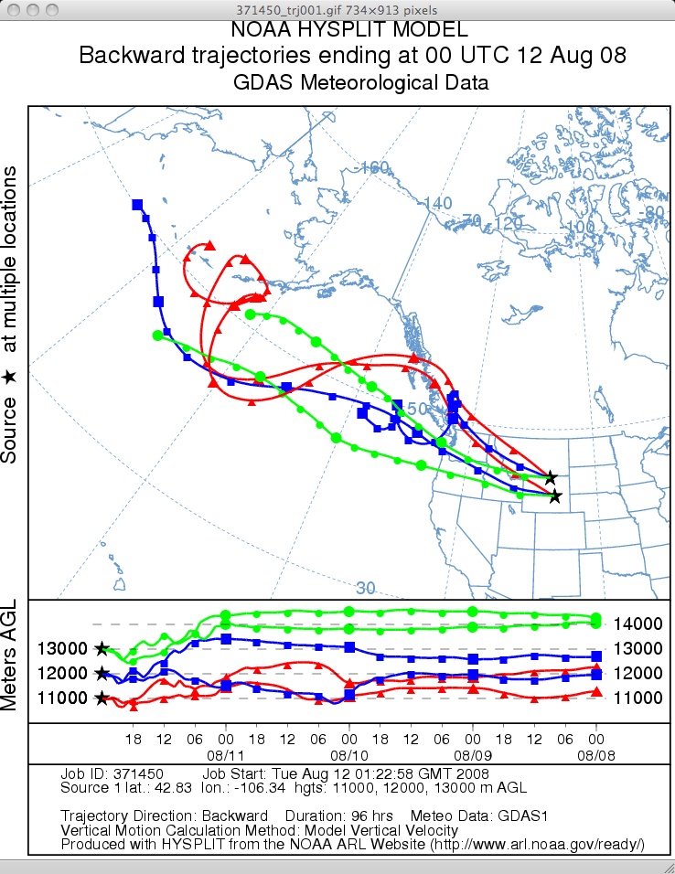
Area of Influence (AOI) / Weighted Emissions Potential (WEP)
HYSPLIT back trajectories from Class I Area (CIA) on 20% Most Impaired Days (MID)
  For example, four times a day (0600, 1200, 1800, 2400 LST) at four different heights above the ground (100, 200, 500, 1,000 m)
  Provides a frequency of occurrence that an air parcel passing over a (i,j) grid cell arrives at a CIA on one of the 20% MID
Use recent AOI/WEP analysis conducted for CenSARA as an example
  HYSPLIT Back Trajectories and IMPROVE 20% MID data for 2012-2016 5-year period
  Example unrelated HYSPLIT Back Trajectory →

Slide 9
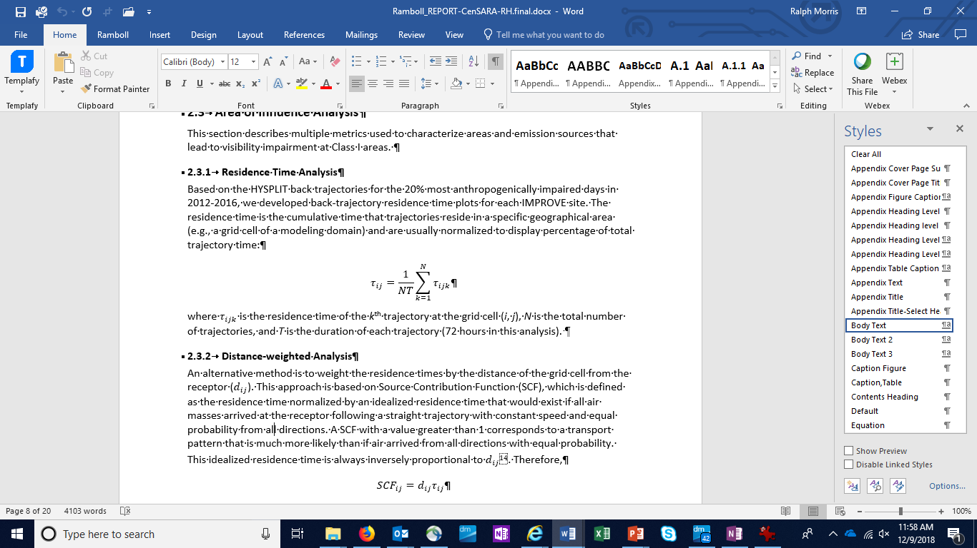
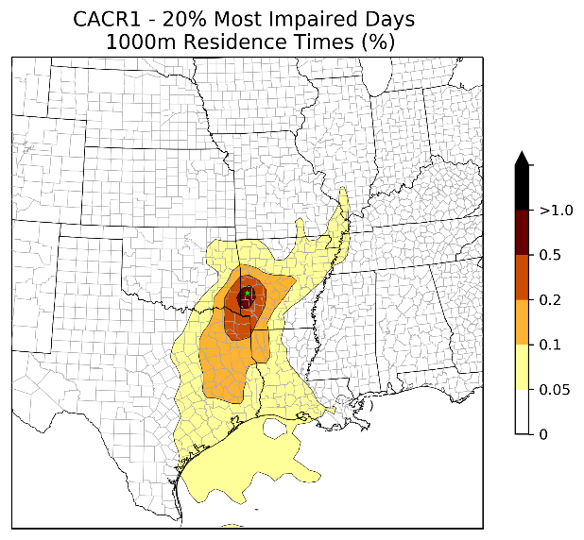
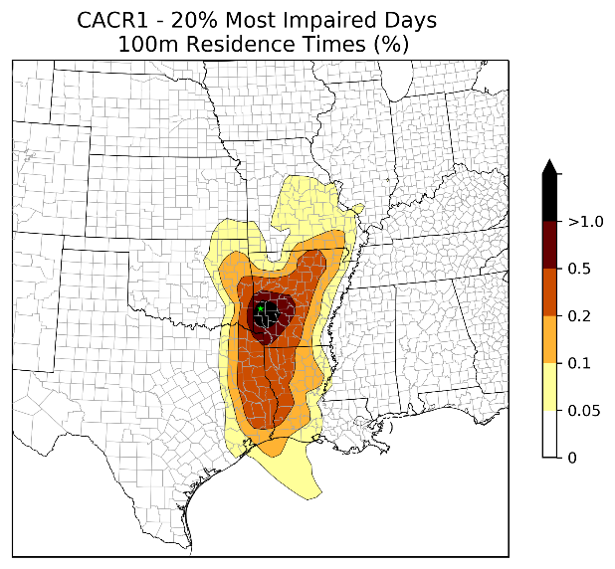
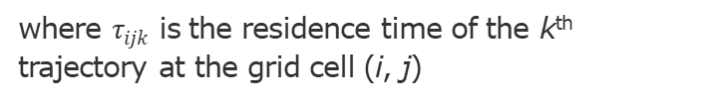
Area of Influence (AOI) / Weighted Emissions Potential (WEP)
Area of Influenced (AOI)
  Residence Time Analysis ( ):
    Amount of time a back trajectory to a CIA on MIDs passes over a location is a measure that can be used to rank source’s potential for contributing to visibility impairment at a CIA on MIDs
  Distance-Weighted Residence Time Analysis or
  Source Contribution Function (SCF)
where $τ_{ijk}$ is the residence time of the k^{th} trajectory at the grid cell (i, j)

Slide 10
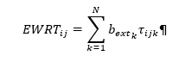
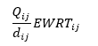
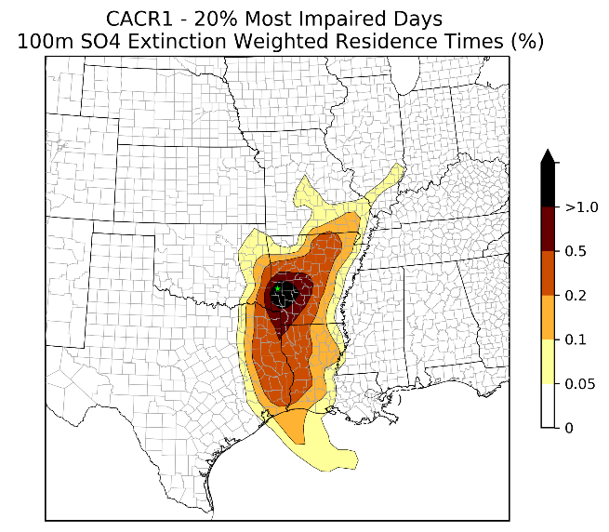
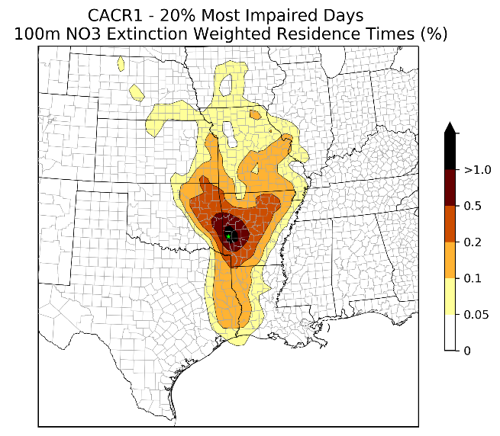
Area of Influence (AOI) / Weighted Emissions Potential (WEP)
Weighted Emissions Potential (WEP)
  Extinction Weighted Residence Time (EWRT):
    Weight the HYSPLIT Residence Time Analysis by the Sulfate (Nitrate) Extinction on each MID
  Weighted Emissions Potential (WEP):
    For each SO2 (NOx) source, weigh the SO4 (NO3) EWRT_{ij} by SO2 (NOx) emissions divided by distance

Slide 11
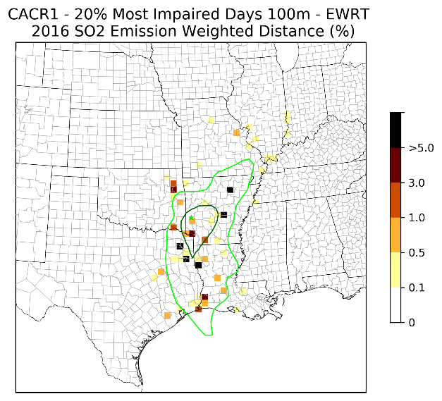
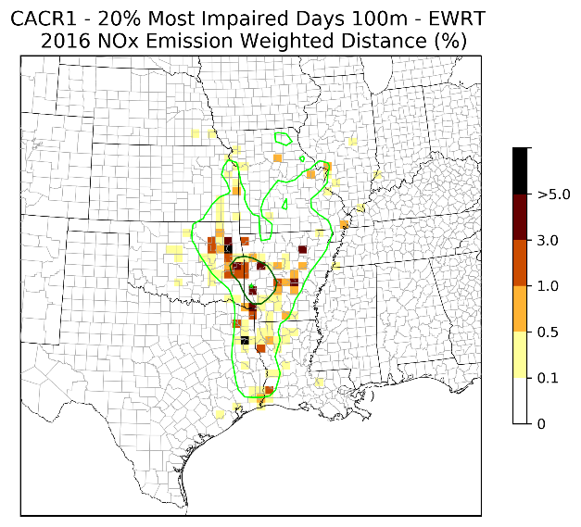
Use WEP [(Q/d) x EWRT] to Rank Sources

Slide 12
Area of Influence (AOI) / Weighted Emissions Potential (WEP)
Advantages:
  Accounts for geography and transport paths to CIA on MIDs
  SO2 (NOx) sources weighted by MID’s SO4 (NO3) extinction
  Less costly than PGM modeling
Disadvantages:
  Uncertainties in HYSPLIT back trajectories
  Does not account for chemical transformation
  Difficult to compare rankings across different CIAs
  Not quantitative
  More costly than Q/d

Slide 13
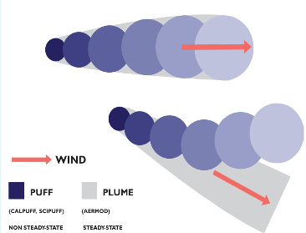
CALPUFF: Lagrangian non-Steady-State Puff Model
CALPUFF tracks emissions from a source using a series of puffs that can overlap
  Includes Reduced Form chemical transformation rates
CALPUFF used extensively in Round 1 Regional Haze SIPs
  Screening tool for when a source is Subject-to-BART
    Source’s visibility impact ≥ 0.5 dv
2003 EPA Modeling Guidelines (Appendix W):
  EPA-preferred far-field (> 50-km) model for inert pollutants
    For example, SO2, PM2.5 CIA PSD SILs/Increments
EPA January 17, 2017 Modeling Guidelines (App W):
  Delist CALPUFF as EPA-preferred far-field model
  EPA states that Chemical Transport Models (CTMs) with full-science chemistry (e.g., PGMS) should be used for single-source ozone and secondary PM impacts

Slide 14
Potential source screening approach using CALPUFF
Use recent WRF data (e.g., EPA’s 2011, 2014, 2015, 2016) and process using MMIF to generate 12-km CALPUFF meteorological inputs
Prepare other CALPUFF inputs (e.g., background ozone and ammonia).
Run CALPUFF for candidate sources and calculate daily visibility impacts at CIA
  Determine source contributions on 20% MIDs and rank sources for conducting Four-Factor Analysis

Slide 15
CALPUFF Screening Approach
Advantages:
  Accounts for geography and transport paths on MIDs
  Can compare source impacts across CIAs
  Less costly than PGMs
  Semi-quantitative
Disadvantages:
  More costly than AOI/WEP
  Limited number of years with WRF data
  Uncertainties in transport/dispersion
  Reduced Form Chemistry
  Not recommended by EPA for secondary PM

Slide 16
EPA Recommendations for Single-Source modeling for Secondary Particulate Matter
EPA Current (Jan 2017) Modeling Guidelines (Appendix W):
  Tier II explicit modeling “involves application of more sophisticated case-specific chemical transport models (CTMs) (e.g., photochemical grid models)”
    https://www3.epa.gov/ttn/scram/guidance/guide/appw_17.pdf
EPA Guidance for Single-Source Modeling of Secondary Pollutants (Dec 2016):
  For Tier II use CTMs with photochemistry on case-by-case basis
  PGMs are one type of CTM that would be acceptable if applied correctly
    https://www3.epa.gov/ttn/scram/appendix_w/2016/EPA-454_R-16-005.pdf
EPA Memo on Use of PGMS for Single-Source Ozone and Secondary PM2.5 (August 2017)
  If applied correctly, CAMx and CMAQ would be acceptable models
    https://www3.epa.gov/ttn/scram/guidance/clarification/20170804-Photochemical_Grid_Model_Clarification_Memo.pdf
Modeled Emission Rates for Precursors (MERPs) for ozone and secondary PM2.5
  Tier I screening tool for PSD ozone and secondary PM2.5 based on CAMx PSAT Source Apportionment
    https://www3.epa.gov/ttn/scram/2018_RSL/Presentations/1-21_2018_RSL-MERPs.pdf

Slide 17
QUANTATIVE Techniques for calculating Single-Source Visibility Impacts
Source Apportionment – PSAT: Particulate Source Apportionment Technology (PSAT)
  PSAT available in the CAMx PGM
  Provides user define sources PM contributions from which visibility impairment can be calculated
  Visibility contributions for given set of atmospheric conditions (e.g., 2011 or 2028 emissions)
Sensitivity Methods – BF & DDM: Brute Force (BF) & Decoupled Direct Method (DDM)
  BF – Base Case and Source Zero-Out Emissions Scenario, difference is Source Contribution
  DDM – Calculate sensitivity for user defined sources, can estimate Source Contributions
    Sensitivity methods change the chemistry so are not true Source Apportionment, but are Prognostic
SCICHEM: Lagrangian puff model with full-science chemistry (like CAMx and CMAQ)
  Simulate individual source or small group of sources using overlapping puffs
  Background concentrations typically obtained by averaging results from CAMx or CMAQ PGM

Slide 18
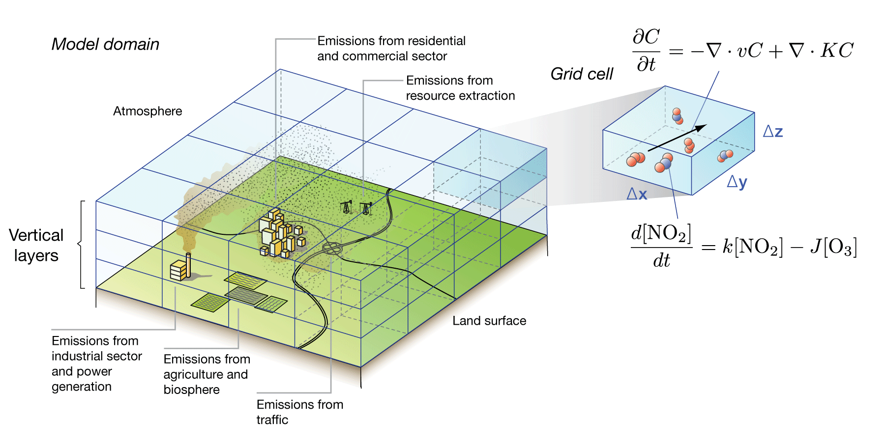
PSAT – Particulate Source Apportionment Technology
Need CAMx PGM Modeling Database
User selects sources for which PM contributions are desired
PSAT uses reactive tracers (tagged species) that run in parallel to the host PGM to track the selected source emissions contributions
  All sources must be tagged (e.g., leftover group) so sum of all tagged sources adds up to total CAMx PM concentration
PSAT can invoke up to 4 families of tagged species:
  (1) SO4; (2) NO3/NH4; (3) Primary PM; and (4) SOA
    SOA most expensive as must track numerous precursor (VOC), PM product (SOA) and intermediate (CG) species.

Slide 19
PSAT – Particulate Source Apportionment Technology
PSAT is compatible with CAMX Plume-in-Grid (PiG) treatment of point source plumes
  Normally emissions from a point source are instantaneously dispersed across a grid cell (e.g., 12-km x 12-km) so fails to capture the near-source plume (e.g., high NOx) chemistry
  CAMx PiG tracks the near-source transport, dispersion and chemistry of a point source plume using a Lagrangian puff model.
  When the size of the puffs are commensurate with a grid cell size, the mass from the puff is transferred to the CAMx grid model
  The puffs from the subgrid-scale PiG module can be sampled using receptors

Slide 20
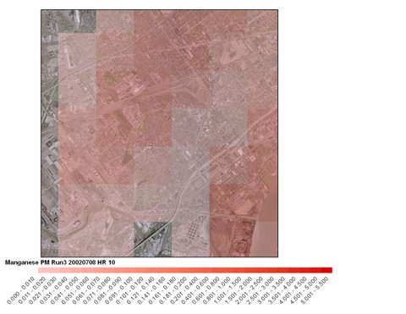
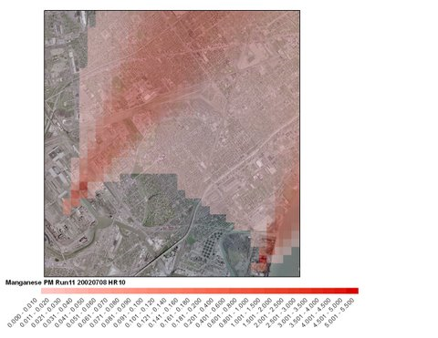
PSAT – Particulate Source Apportionment Technology
PSAT compatible with the CAMX Plume-in-Grid (PiG) module
Example CAMx results using 1-km grid cell vs. 4-km grid cell with PiG and sampling receptors
CAMx 1 km grid
CAMx 4 km grid + PiG 200 m sampling grid

Slide 21
PSAT – Particulate Source Apportionment Technology
Example – VISTAS/ASIP individual contributions of 31 sources to PM2.5 concentrations
(circa 2007-2008):

Slide 22
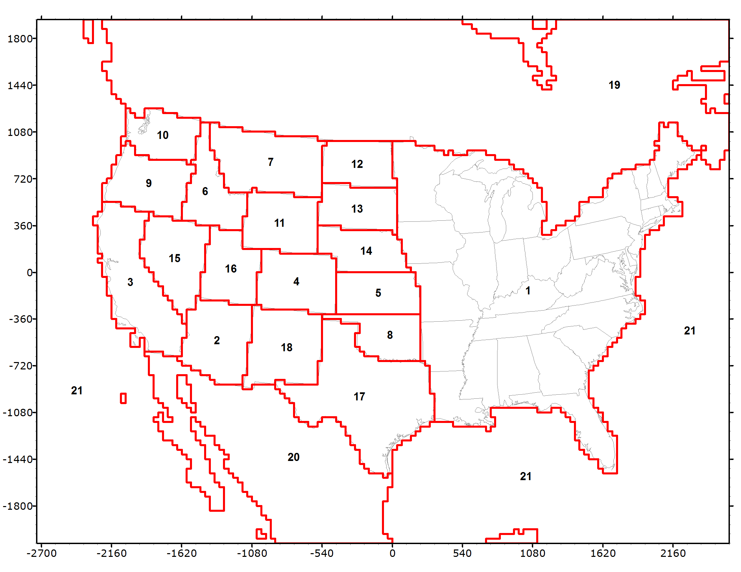
PSAT – Particulate Source Apportionment Technology
WRAP Western Air Quality Study (WAQS) CAMx 36/12-km Source Apportionment
Round 1: Geographic Regions
Round 2: Source Sectors
  Natural (Bio, LNOx, SS, WBD)
  Wildfires (WF)
  Rx+Ag Fires
  O&G
  EGU Point
  Other Point
  On-Road
  Non-Road
  Remainder Anthro

Slide 23
PSAT – Particulate Source Apportionment Technology
Advantages:
  Provides quantitative visibility contribution to visibility impairment on 20% MID and all days
  Consistent contribution metrics across CIAs
  Cost-effective when analyzing contributions of multiple individual sources
  Consistent with PGM visibility impacts and Reasonable Progress calculations
  Consistent with EPA Modeling Guidelines
Disadvantages:
  Requires CAMx PGM database
  Can be computationally extensive when analyzing many many sources
  Typically only available for one year
  Contributions for Emissions Scenario Simulated – other years may be different

Slide 24
Sensitivity Methods – BF and DDM
Brute Force (BF)
  Can be used with CAMx, CMAQ or any Model
  Conduct Base Case
  Conduct Sensitivity Case
    For example, single-source zero-out emissions scenario
  Difference in concentrations is interpreted as a source contribution
Decoupled Direct Method (DDM)
  Instrumented in CAMx and CMAQ
  User defines parameters for DDM sensitivity analysis
    Works similar to PSAT for emissions
  Obtain PM concentration sensitivities to emissions (dc/de)
  Post-process to get source contributions

Slide 25
Sensitivity Methods – BF and DDM
Brute Force (BF)
Advantages:
  Quantitative, can compare across CIAs
  Easy to implement and explain
  Cost effective for one or not very many sources
  Can be used with any model (CAMX/CMAQ)
  Consistent with EPA Modeling Guidelines
Disadvantages:
  Requires PGM database
  Can be costly for multiple sources
  Sensitivity, not true source contributions
Decoupled Direct Method (DDM)
Advantages:
  Quantitative, can compare across CIAs
  Can get multiple source contributions in single run
  Implemented in CAMx and CMAQ
  Consistent with EPA Modeling Guidelines
Disadvantages:
  Requires PGM database
  Sensitivity, not true source contributions
  Is resource intensive (much more than PSAT)
  Difficult to explain and interpret

Slide 26
SCICHEM – Lagrangian puff model with chemistry
  A Lagrangian puff dispersion model (think CALPUFF dispersion) with full chemistry (think CAMx and CMAQ chemistry)
    SCICHEM v3.1/v3.2 is a stand alone model
    Includes visibility post-processor to get single-source visibility impacts
  Can be used to model impacts of a single source or a small number of sources to ozone and PM_{2.5}
  Model dispersion evaluated for tracer studies and AERMOD databases
  Dispersion and chemistry evaluated against aircraft measurements of reactive plumes from power plants and petrochemical facilities
  Requires less computing power and setup time for single source applications compared to Photochemical Grid Models (PGMs)
  Runs on Windows 7 and Windows 10 (or Linux)

Slide 27
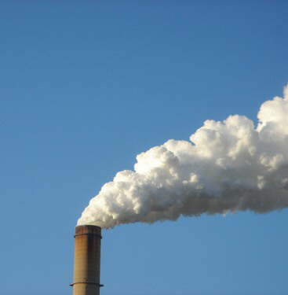
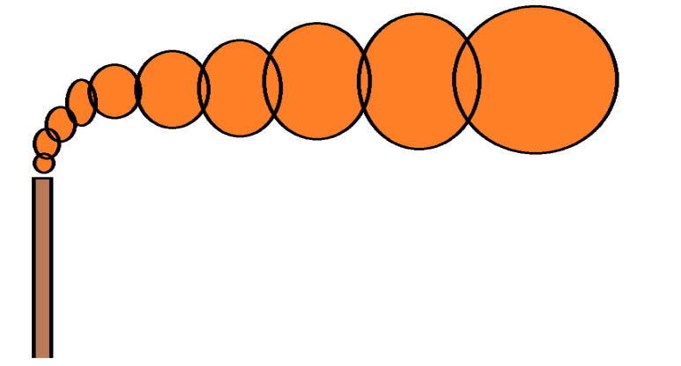
SCICHEM – Lagrangian puff model with chemistry
Plume represented as a succession of 3-D Gaussian puffs
State-of-the-science puff dispersion based on SCIPUFF (Second Order Closure Integrated Puff Model)
Complex photochemistry similar to CMAQ and CAMx
Chemistry on overlapping puffs to correctly account for interaction among puffs and with background-allows treatment of non-linear chemistry
Suitable for both short-range and long-range transport applications

Slide 28
SCICHEM – Lagrangian puff model with chemistry
Data Needs:
  Meteorology – typically WRF annual hourly 3-D
  Source emissions and stack characteristics – like AERMOD/CALPUFF
  Background concentrations -- plume chemistry in SCICHEM dependent on specified chemical environment into which emissions are released
SCICHEM v3.1 release package includes regional diurnally and vertically varying monthly background chemistry files:
  By state (sub-state level for larger states like CA and TX)
  Obtained from a CAMx 2011 12-km resolution CONUS simulation
    Could easily generate background for 2028 atmospheric conditions if 2028 CAMx or CMAQ output is available
SCCHEM v3.2 annual long-range-transport (e.g., CIA AQRV) simulation takes approximately a week using a single CPU core

Slide 29
SCICHEM – Lagrangian puff model with chemistry
Advantages:
  Consistent with EPA Modeling Guidelines
  Cost-effective for single-source impacts or for a few sources
  Can run on Windows or Linux
  PGM modeling expertise and Linux Clusters not needed
Disadvantages:
  New modeling system
  No MPI/OpenMP multi-processing capability
    Single-source runs take ~week
    Multiple sources longer
  Some expertise may be needed
  Potential inconsistencies with PGM impacts

Slide 30
Discussion – Single-Source Visibility Modeling
Screening Tools:
  Q/d is easy to do, but should be done consistently across western U.S. region
  AOI/WEP analysis would likely provide a better screening tool as it is tied to a CIA’s MIDs, but likely requires contractor support
    CenSARA AOI/WEP analysis cost ~$42K, expect WRAP to be the same even with many more CIAs because scripts and approach already set-up
  Not sure what benefits CALPUFF brings over other tools
Quantitative Tools:
  Sensitivity methods least attractive given many sources need to be analyzed (BF out) and DDM is costly to use and difficult to interpret
  PSAT vs. SCICHEM would both be viable quantitative approaches
    PSAT likely require contractor support and consistent with 2028 Reasonable Progress modeling
    SCICHEM could be set-up on IWDW servers for states to run

Slide 31
Further Discussion

